Slide 1
Better Leaf
NOVEL BIOPESTICIDES FROM INDIGENOUS MEDICINAL PLANTS

Slide 2
Opportunity
Global bio pesticide market was 10 Million dollars
Timorex gold won the best bio pesticide in the world (agro award)
200 million dollar evaluation for bio pesticide company
Dani Neifeld has founded
World market growing rapidly to the 5 billion dollar mark with 15.7 % CGR
425 million dollar paid for bio pesticide company by Bayer Ag –the gate for big investments opened
2011
2012
2014
2016
2022
The global market is constantly looking for new products

Slide 3
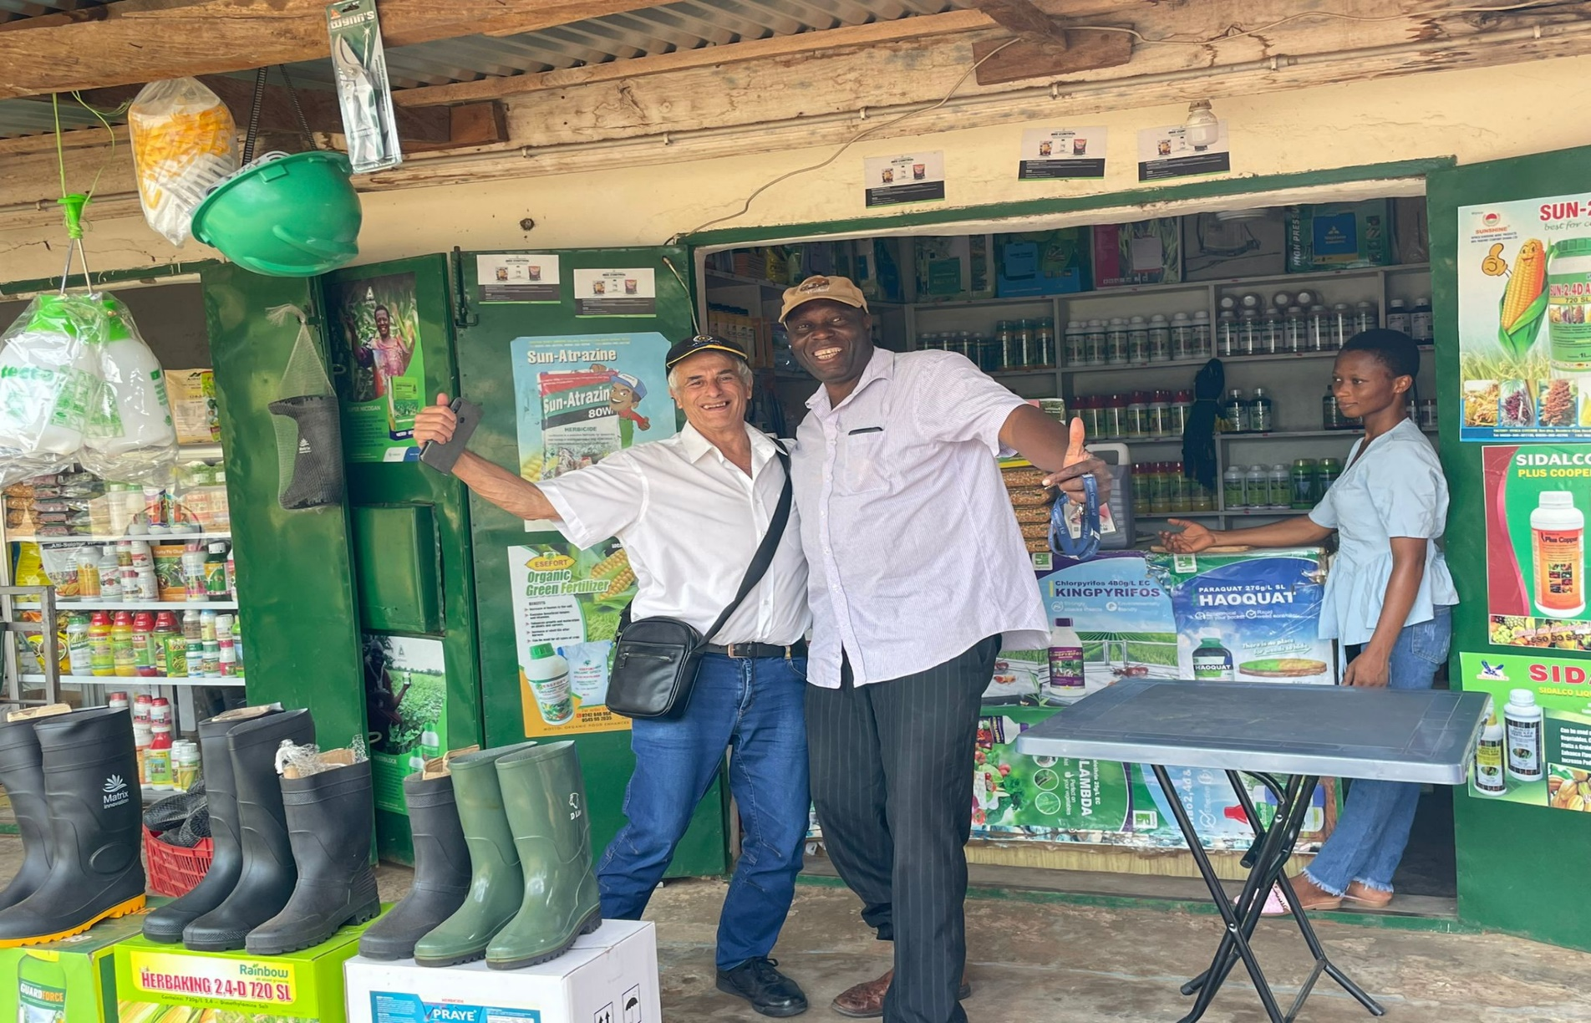
Glocal Problem west Africa case:
95% of pesticide in Ghana are imported. farmers use less pesticide due to price and availability Fraudulent pesticides account for 34% of regional pesticide sales, 27% of them are unregistered and 7% counterfeits
Source :FAO

Slide 4
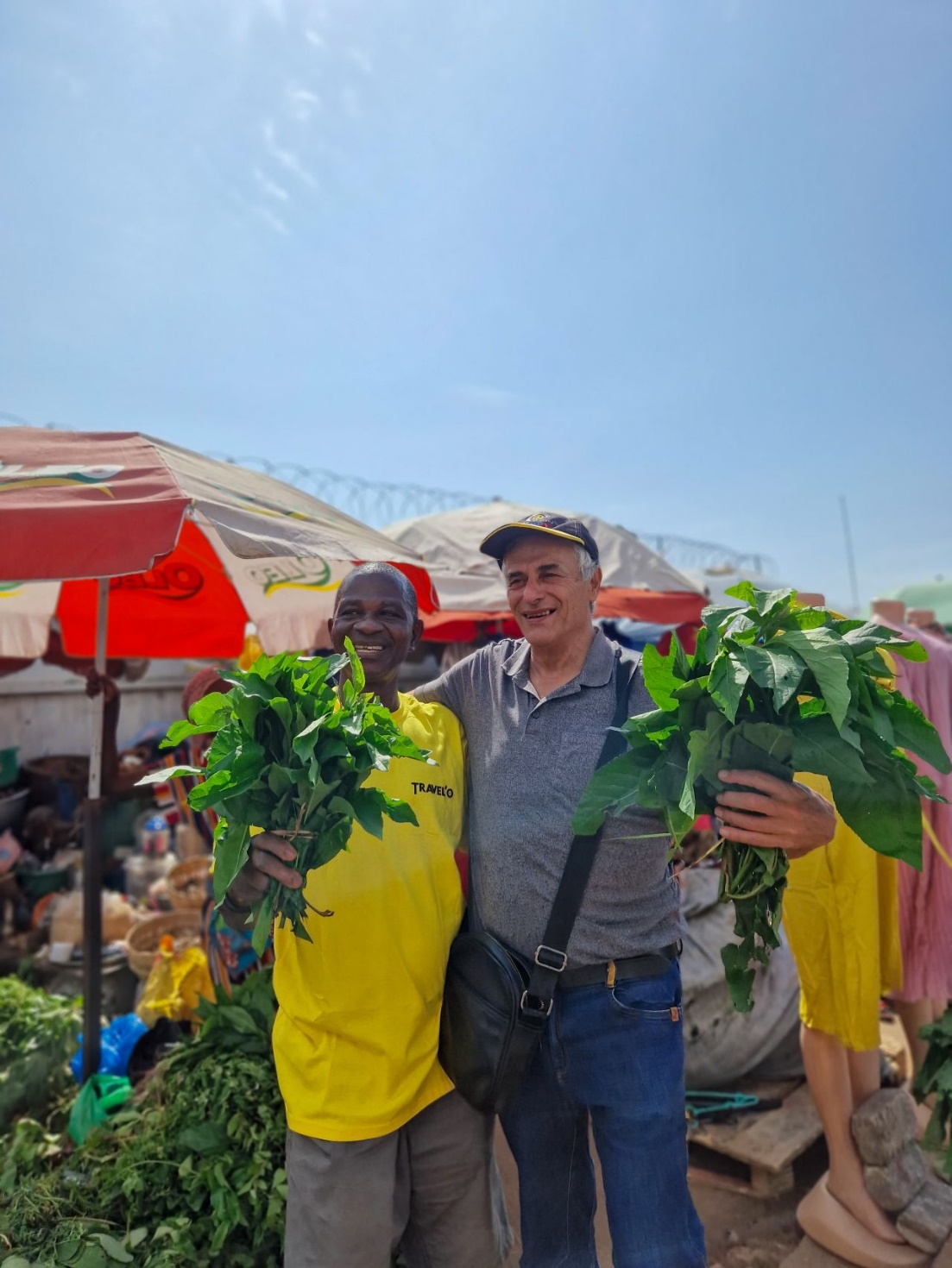
The solution
Better leaf identified a local promising plant used traditionally as a medicinal plant.
The plant shows wide spectrum of potentially beneficial Phyto-chemicals
Can be utilize in Aquaculture and Agriculture as a remedy from biological source
Active groups

Slide 5
The Better Leaf vision
Better Leaf Ltd- and – Ghanaian company will partner and become a global and local supplier of bio rational products Based on Ghana locally grown medicinal plants.
WE will help mitigate claimant change and
create:
New jobs for young women and men in Ghana.
New cash crop for farmers and a new industry venture.
New export and revenue for Ghana and the farmers.

Slide 6
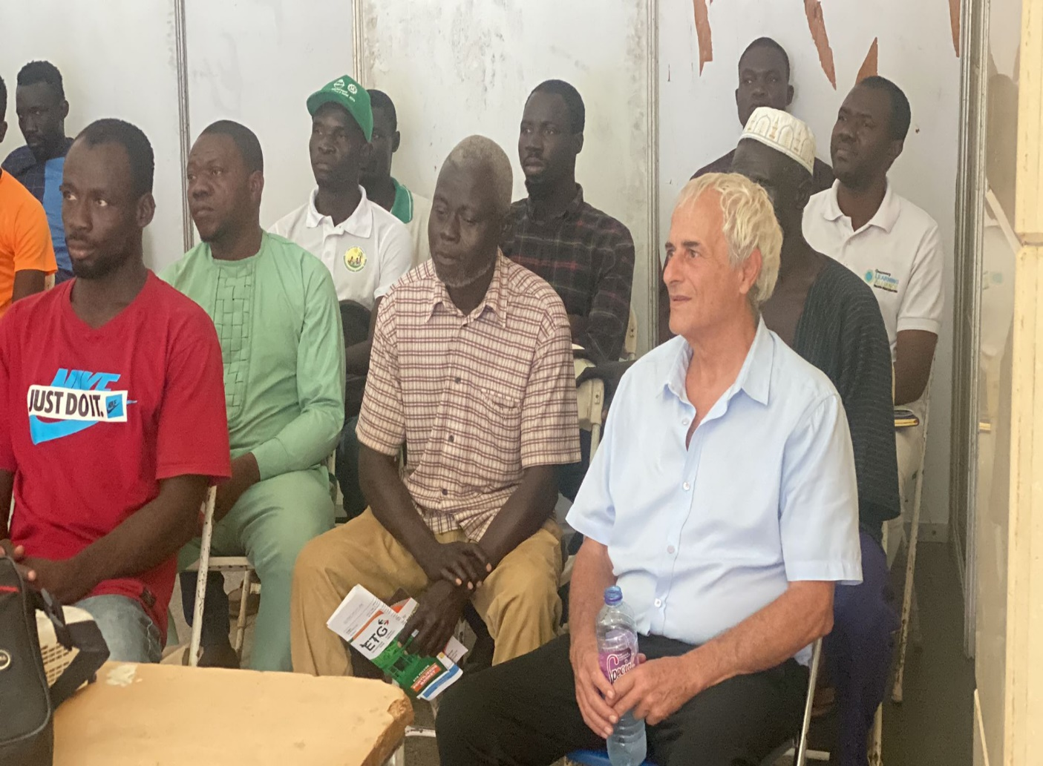
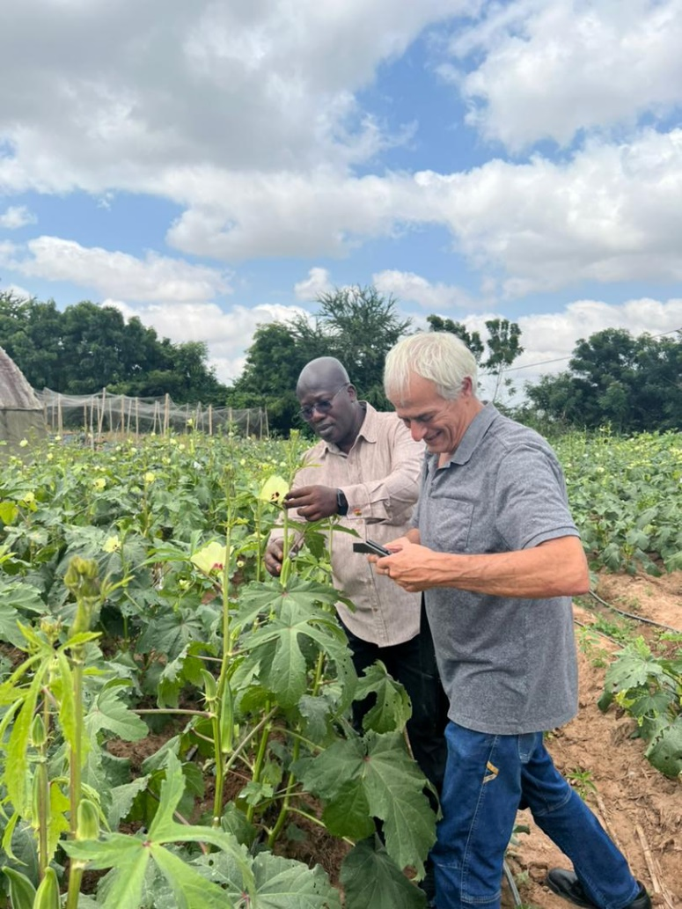
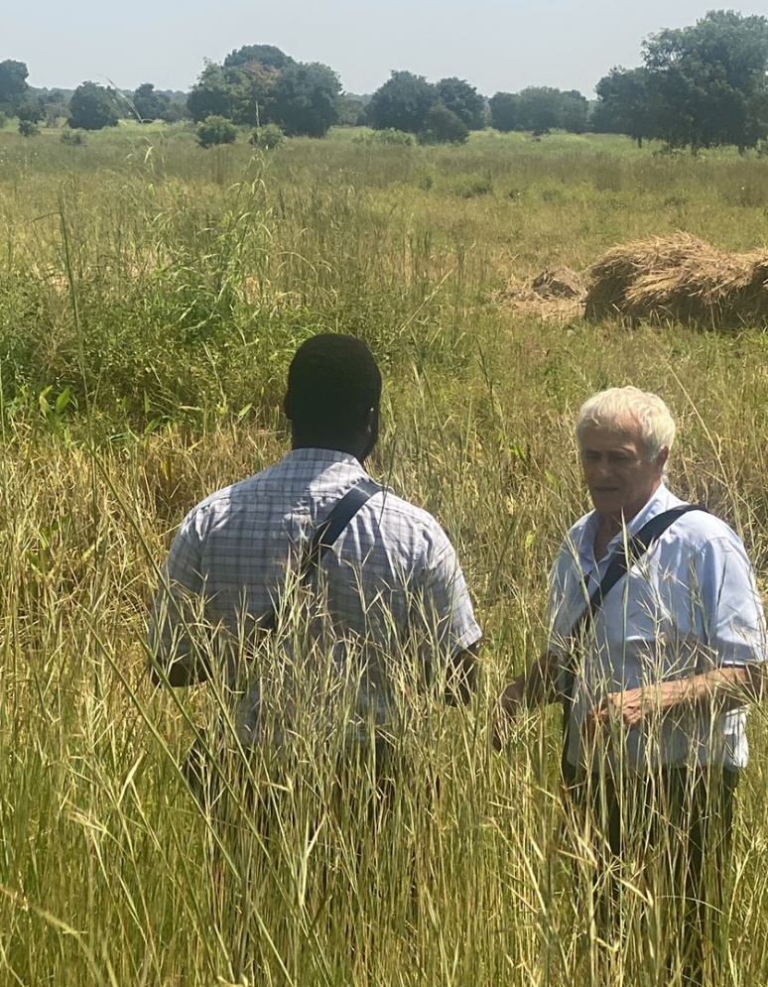
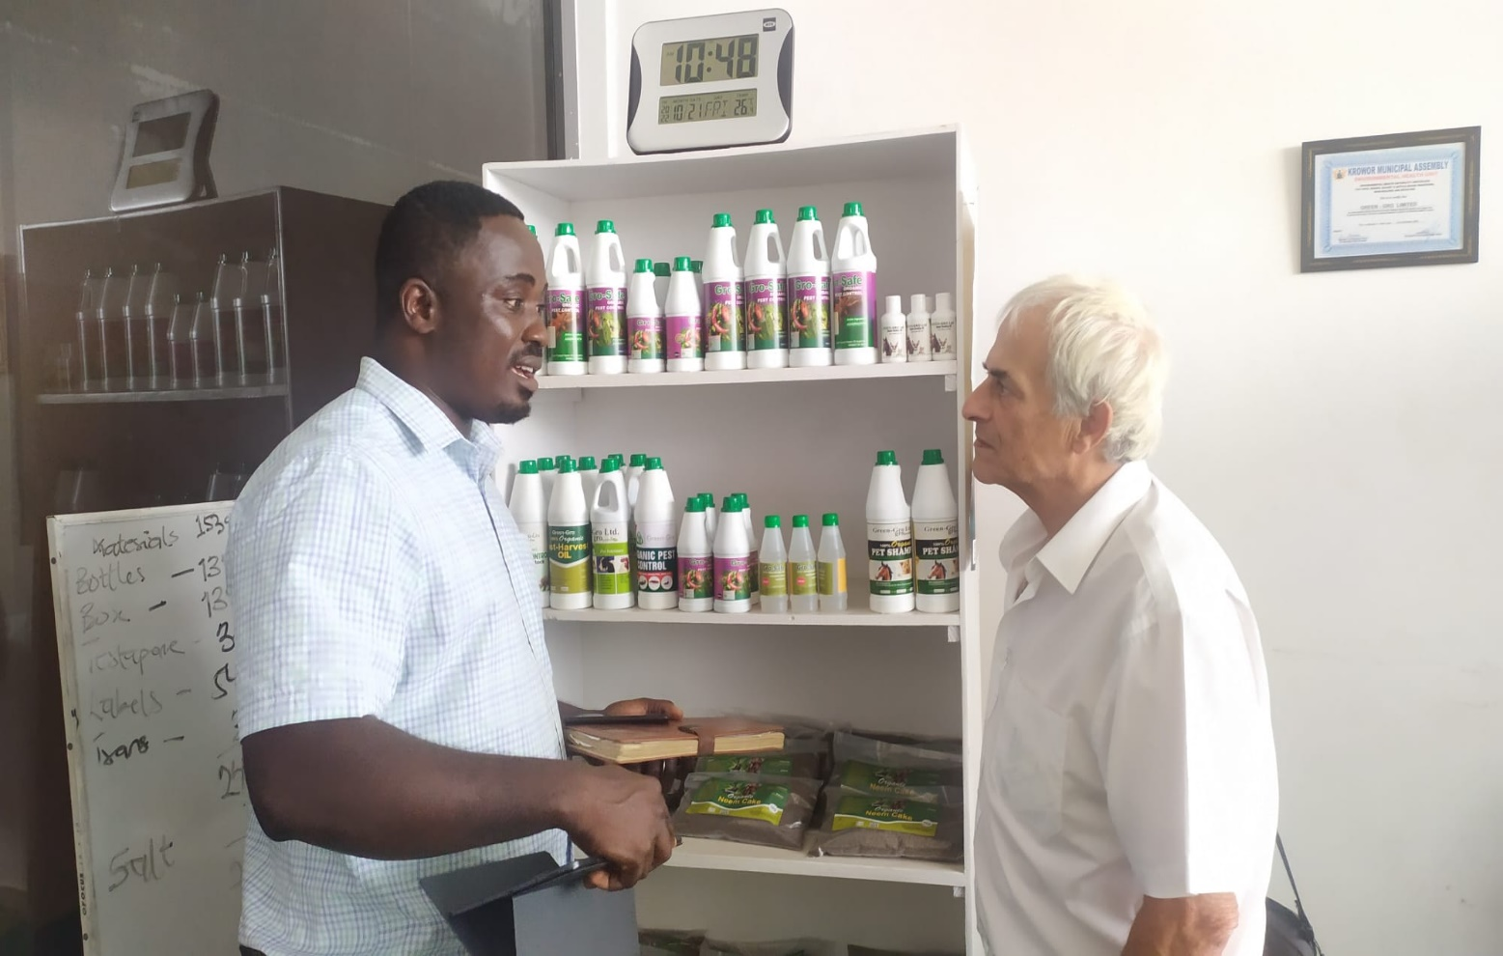
The field is ready for Better leaf venture:
Production
Farmers in Tamale – waiting to start
Research
Research - University of Ghana - Center of Crop Improvement
Registration
EPA – Registration department
Finance
Stanbic Bank – Agribusiness Department
Marketing- Mega concept Company
MOFA (Ministry of Food and Agriculture) - Extension Officers
Formulation, Manufacturing – Green gro Company

Slide 7
Road Map : 2023 -2025
2024
First q 2023
3 q 2023
Company establishment
Investment
Team recruitment
Partnership
Plants model farm
R&D Capacity building
Formulation
Toxicology
Lab tests efficacy
Registration
Field trials
Demonstration
Scaleup production
Commercialization
Formulation second product
Go – Global.

Slide 8
Budget forward
2023 1st quarter
Estimated expanses : 36300 USD
Company establishment, Forming partnerships, POC
Estimated investments : 18000 USD
Pears program, founders.
2023 2nd quarter
Estimated expanses : 48950 USD
Demo farm, Biomass production
Estimated investments : 150000 USD
VC, private investors
2023 3rd quarter
Estimated expanses : 39050 USD
Formulation
0
2023 4th quarter
Estimated expanses : 40150 USD
Production
Estimated investments for 2024 : 200000 USD
2023 expanses
36300 | Q1
48950 | Q2
39050 | Q3
40150 | Q4
TOTAL $- 129350

Slide 9
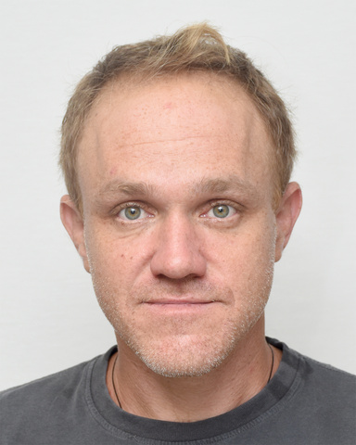
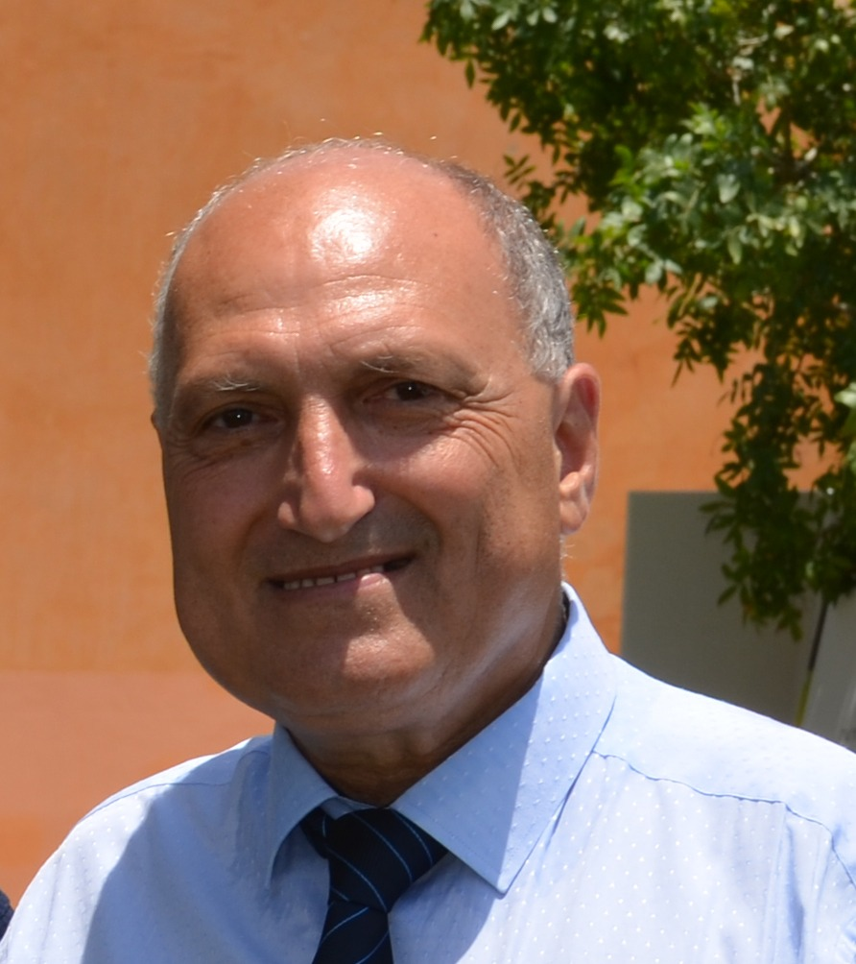
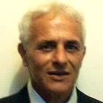
The Team that can make it a successes
consultancy
Dina Amir - Finance
Prof. Moshe Reuveni - phytopathology
Dani Neifeld- CEO founder
Ben Katzir –R&D founder
Kirk Amoah –market penetration
Philamona Brittain – manufacture
Daniel– lead Agronomist
Ahmad- marketing & regulation
Dr. Raanan Ariav - Aquaculture

Slide 10
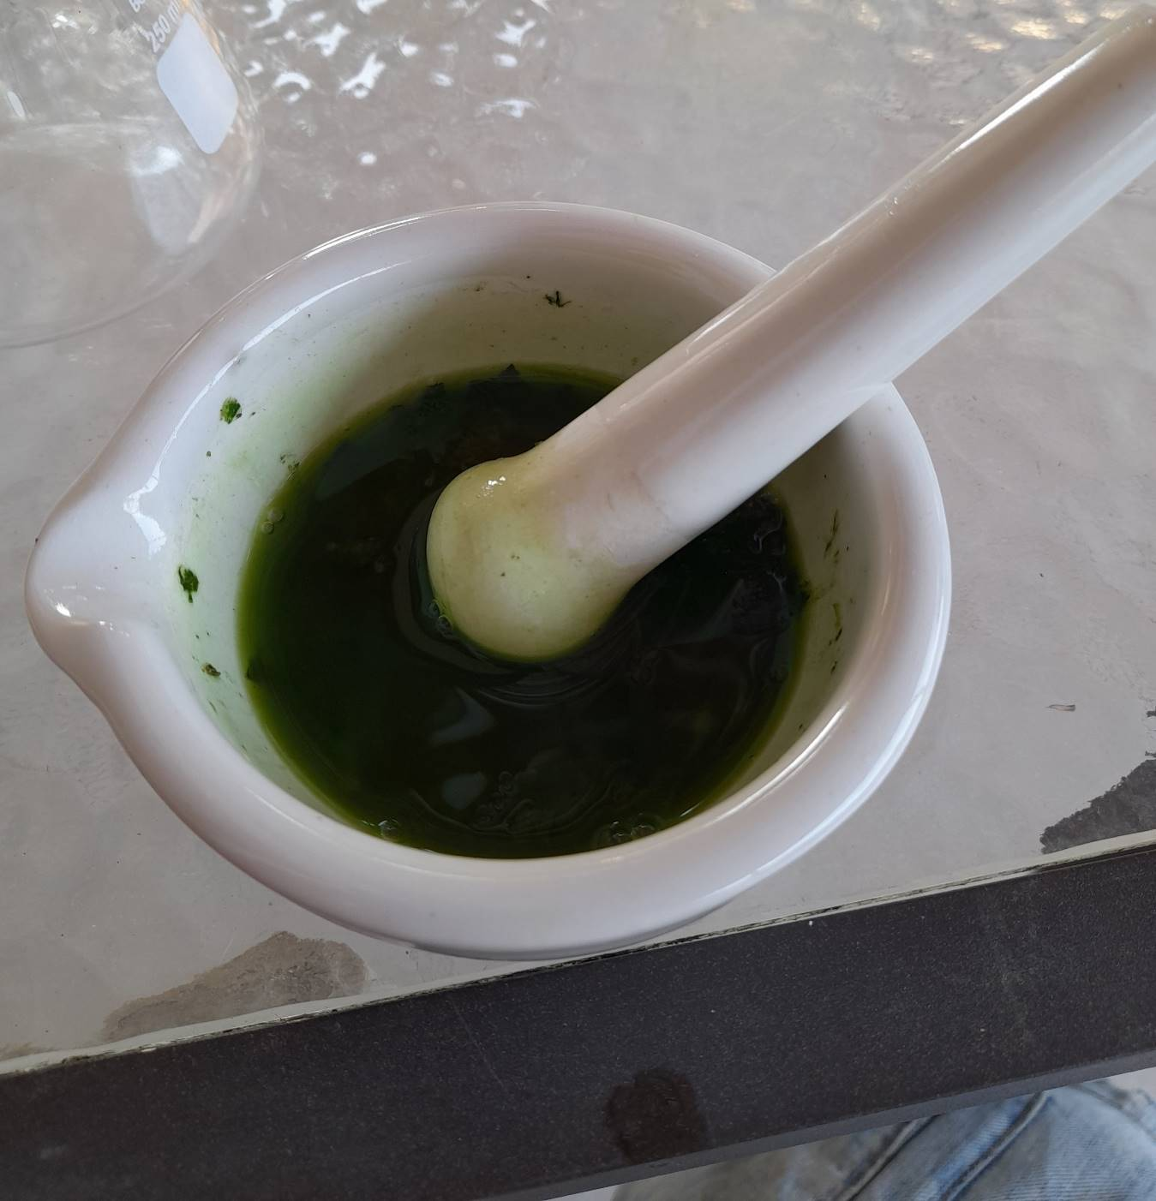
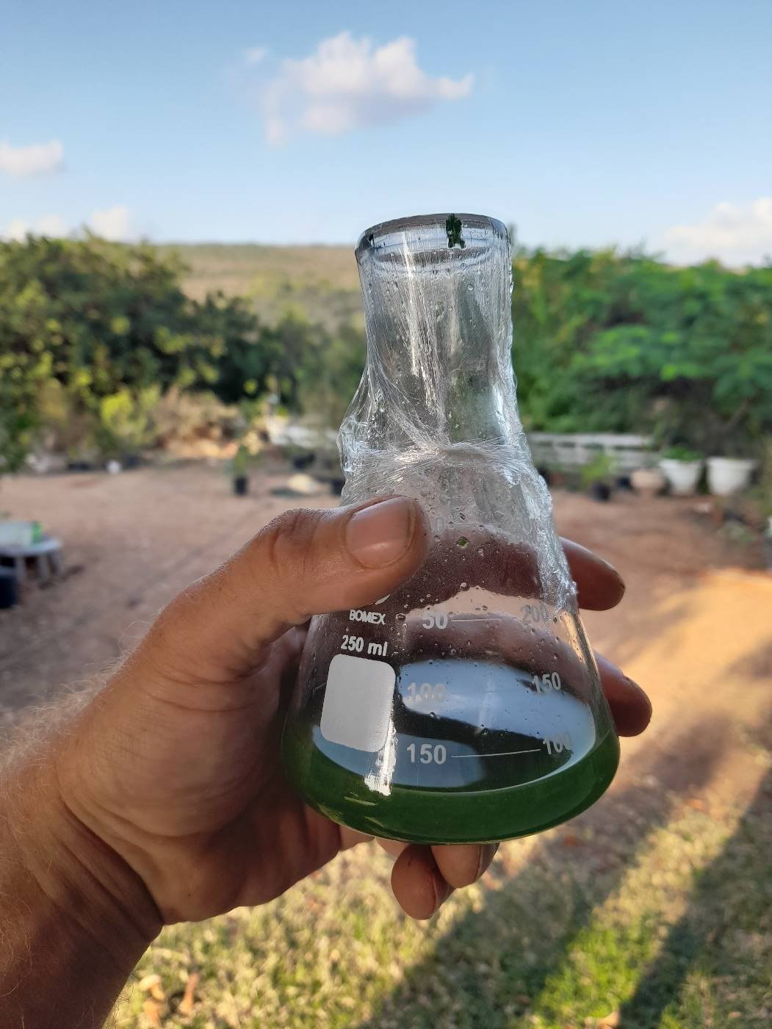
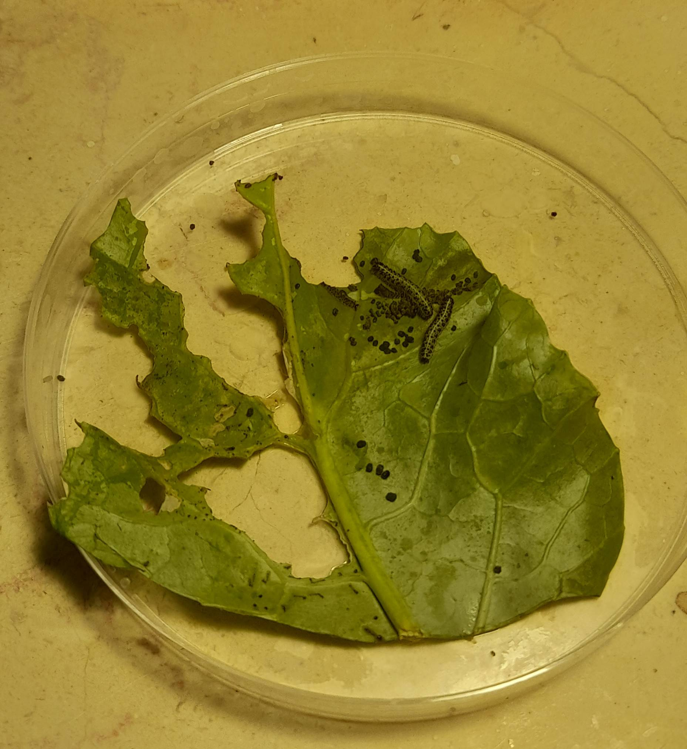
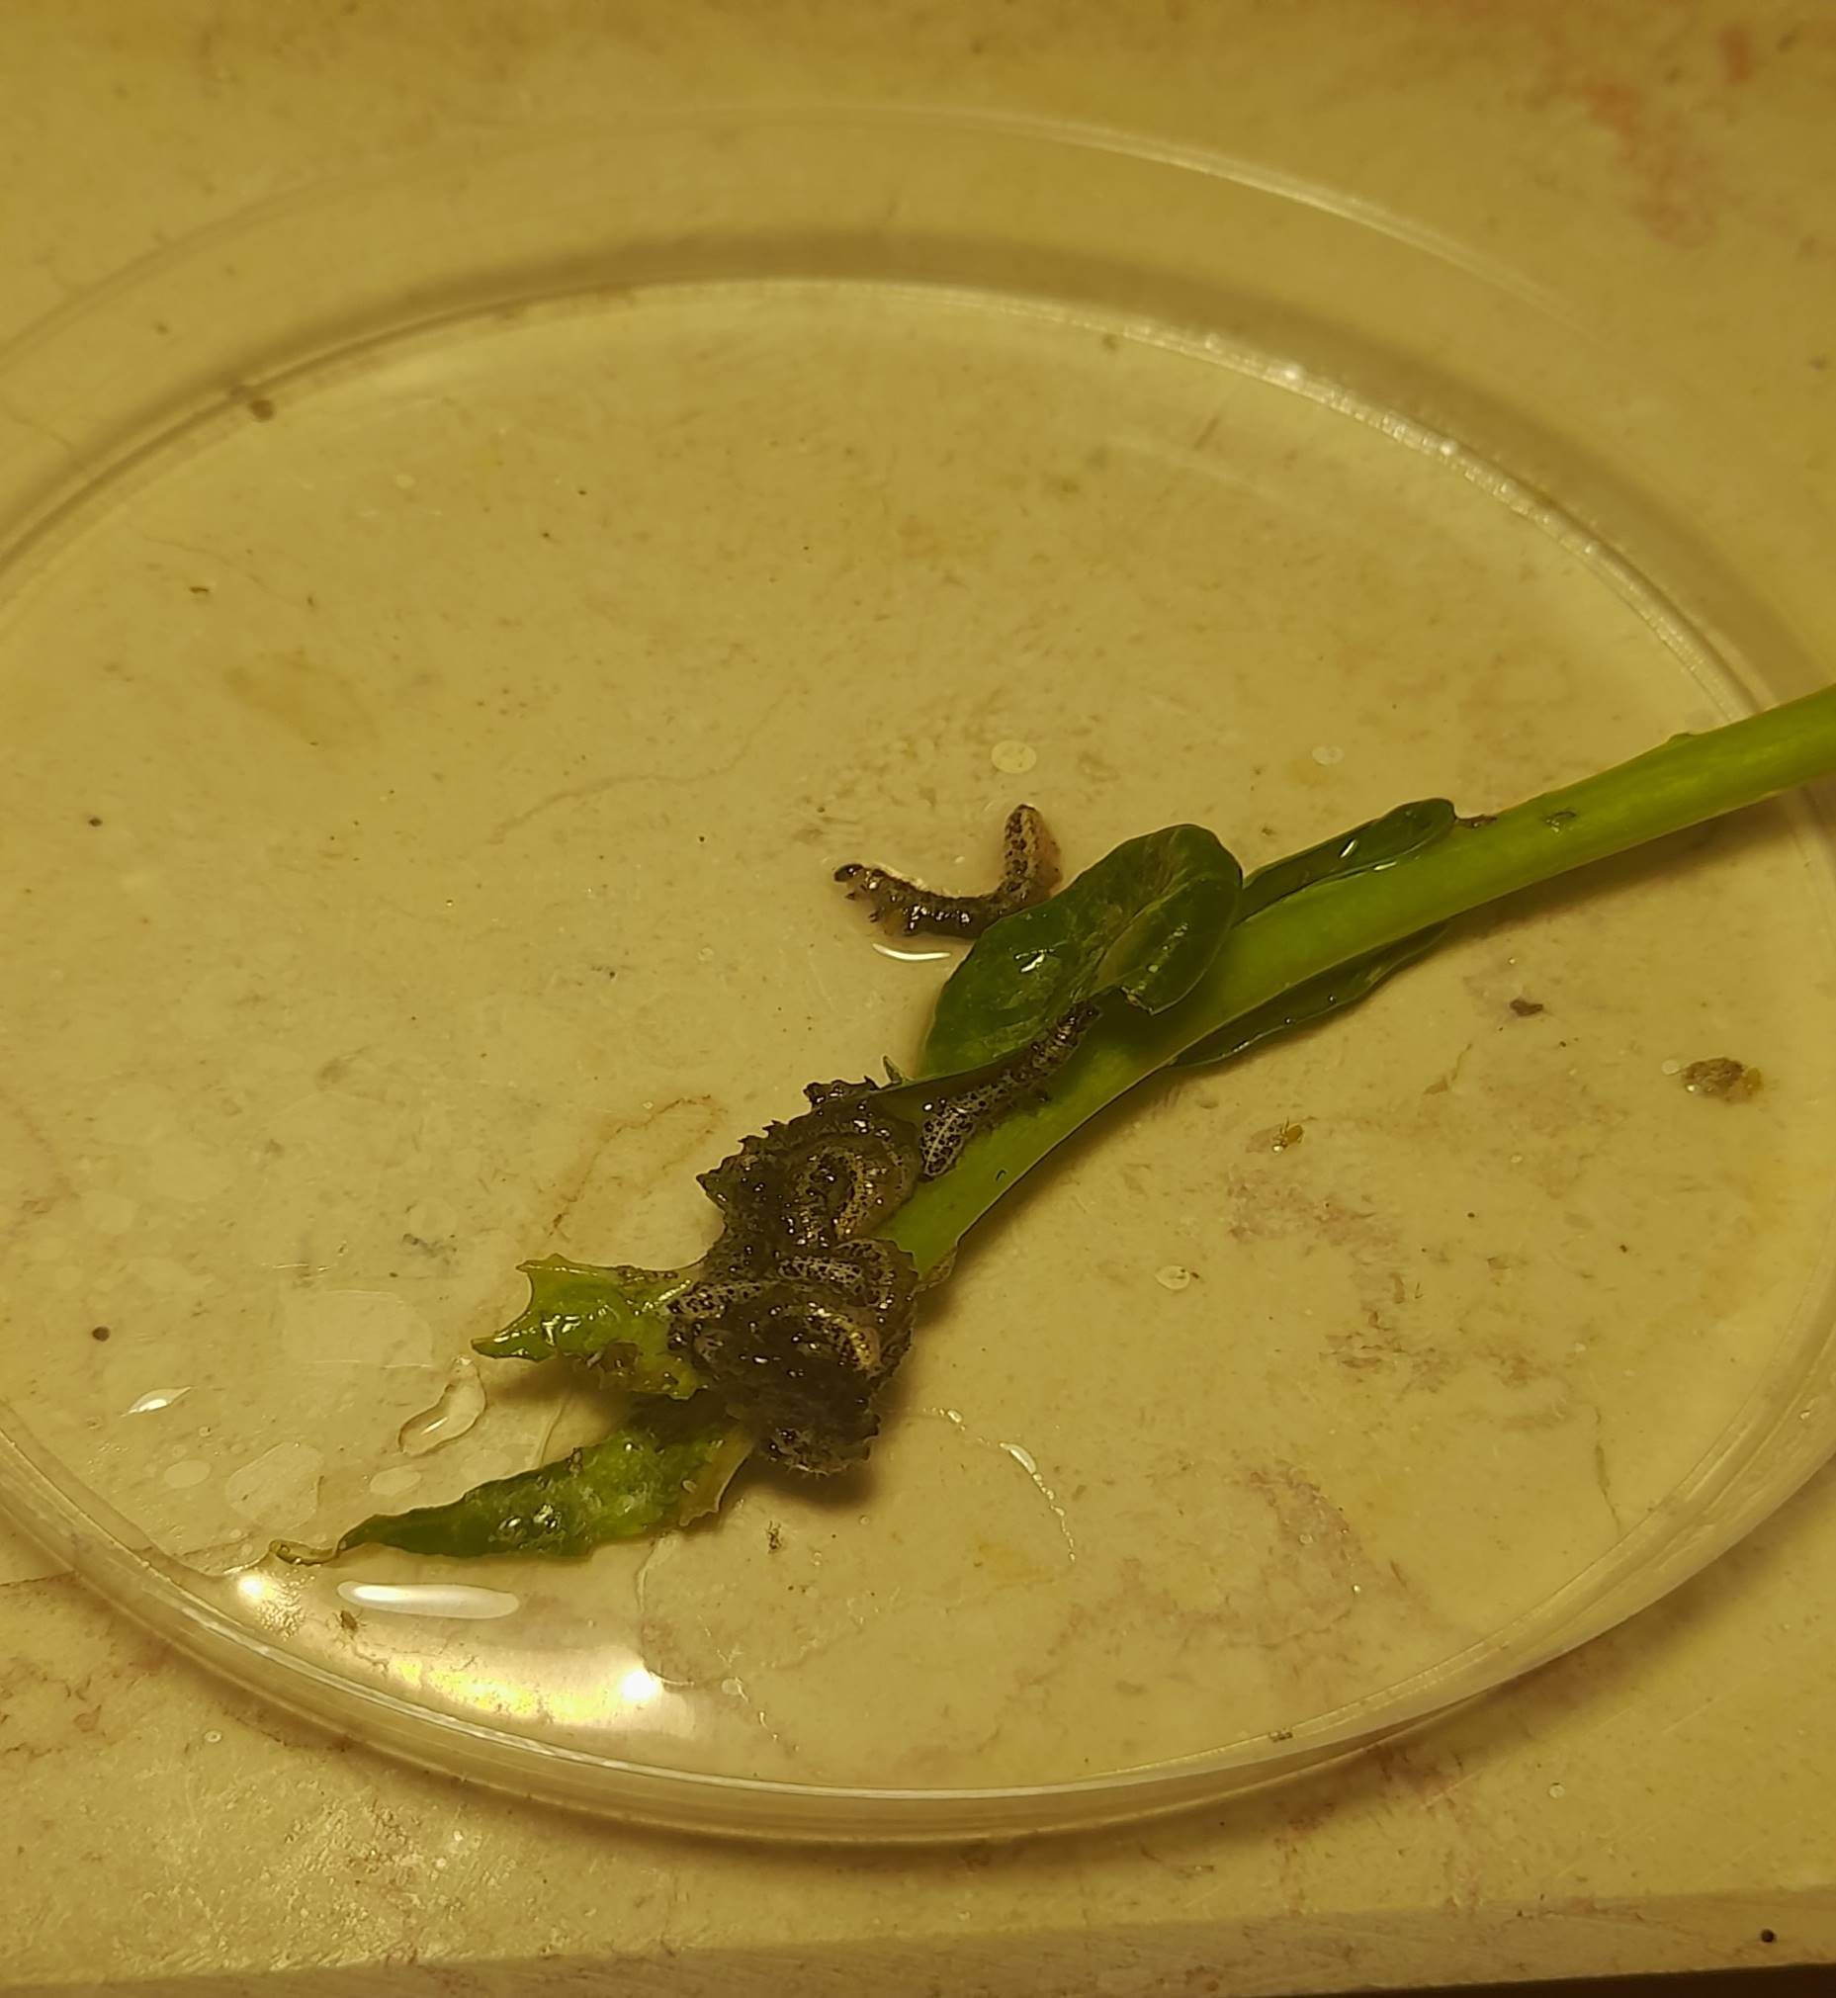
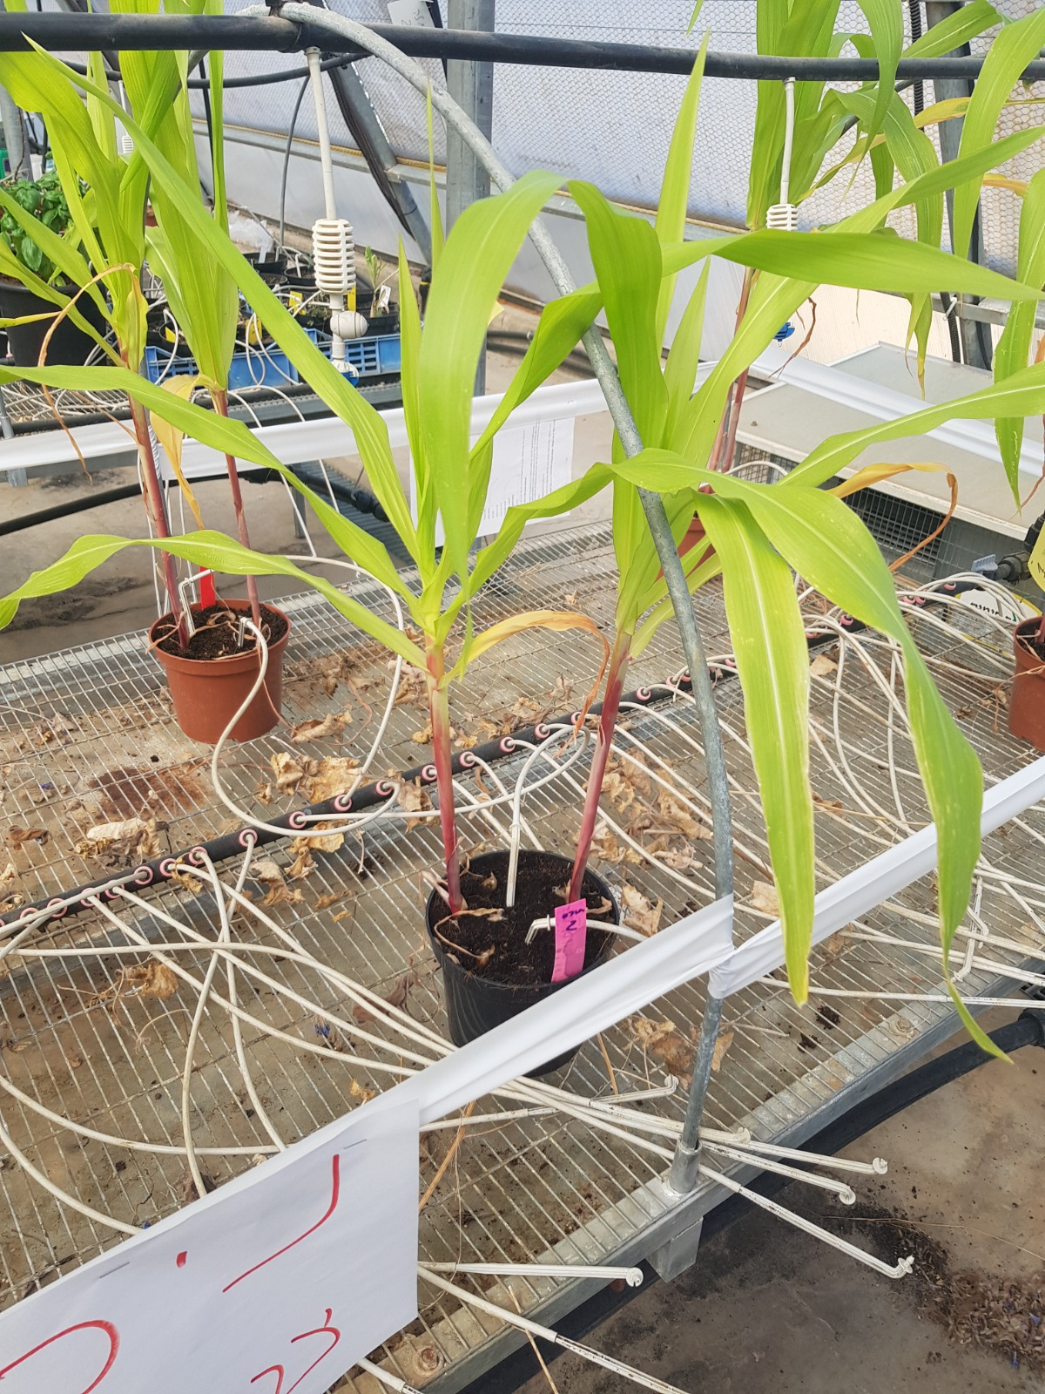
Toward P.O.C : Preliminary results
Control
Treatment

Slide 11
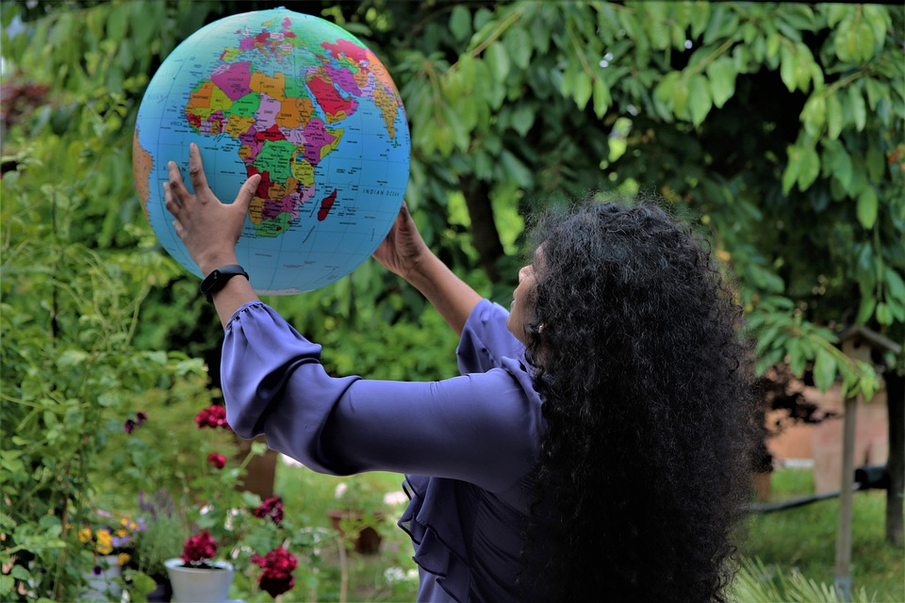
“Se wo were fi na wosankofa a yenkyi,“
“It is not wrong to go back for that which you have forgotten.”

