Slide 1
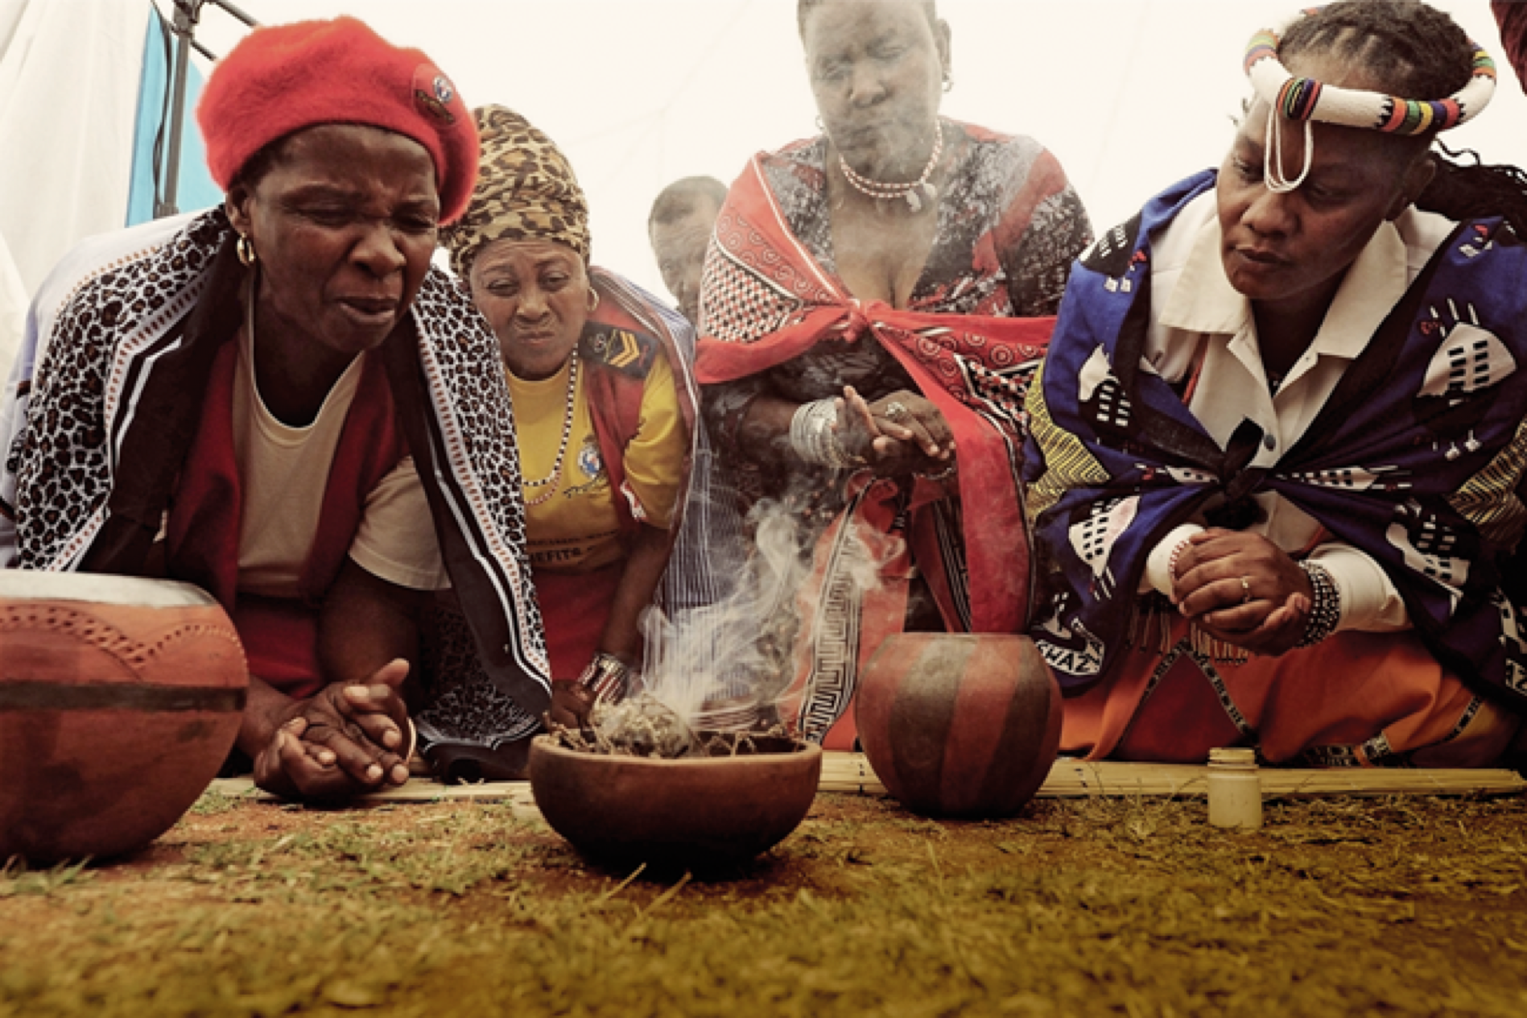

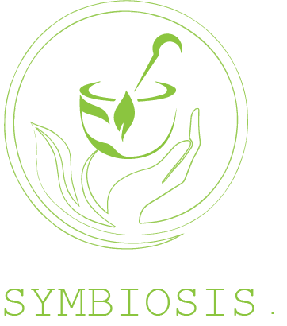



Slide 2
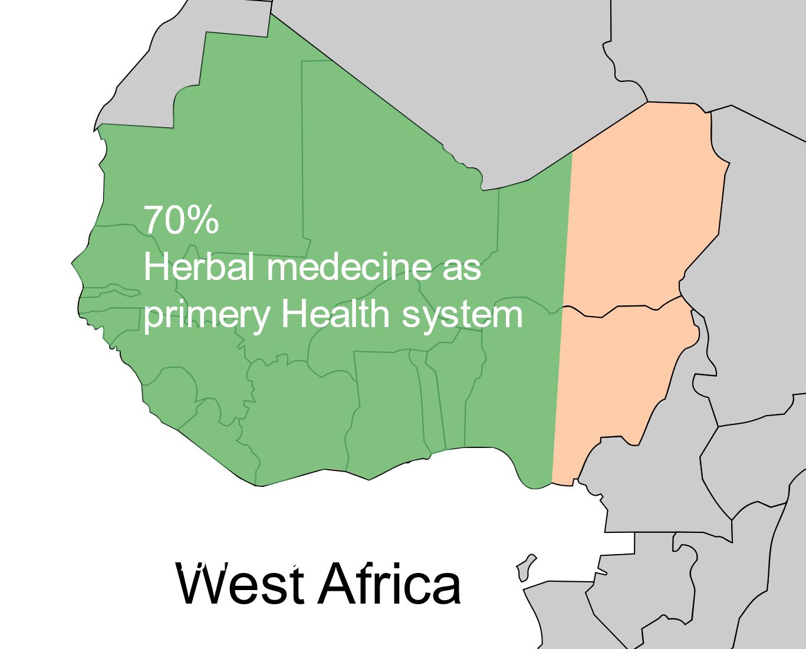
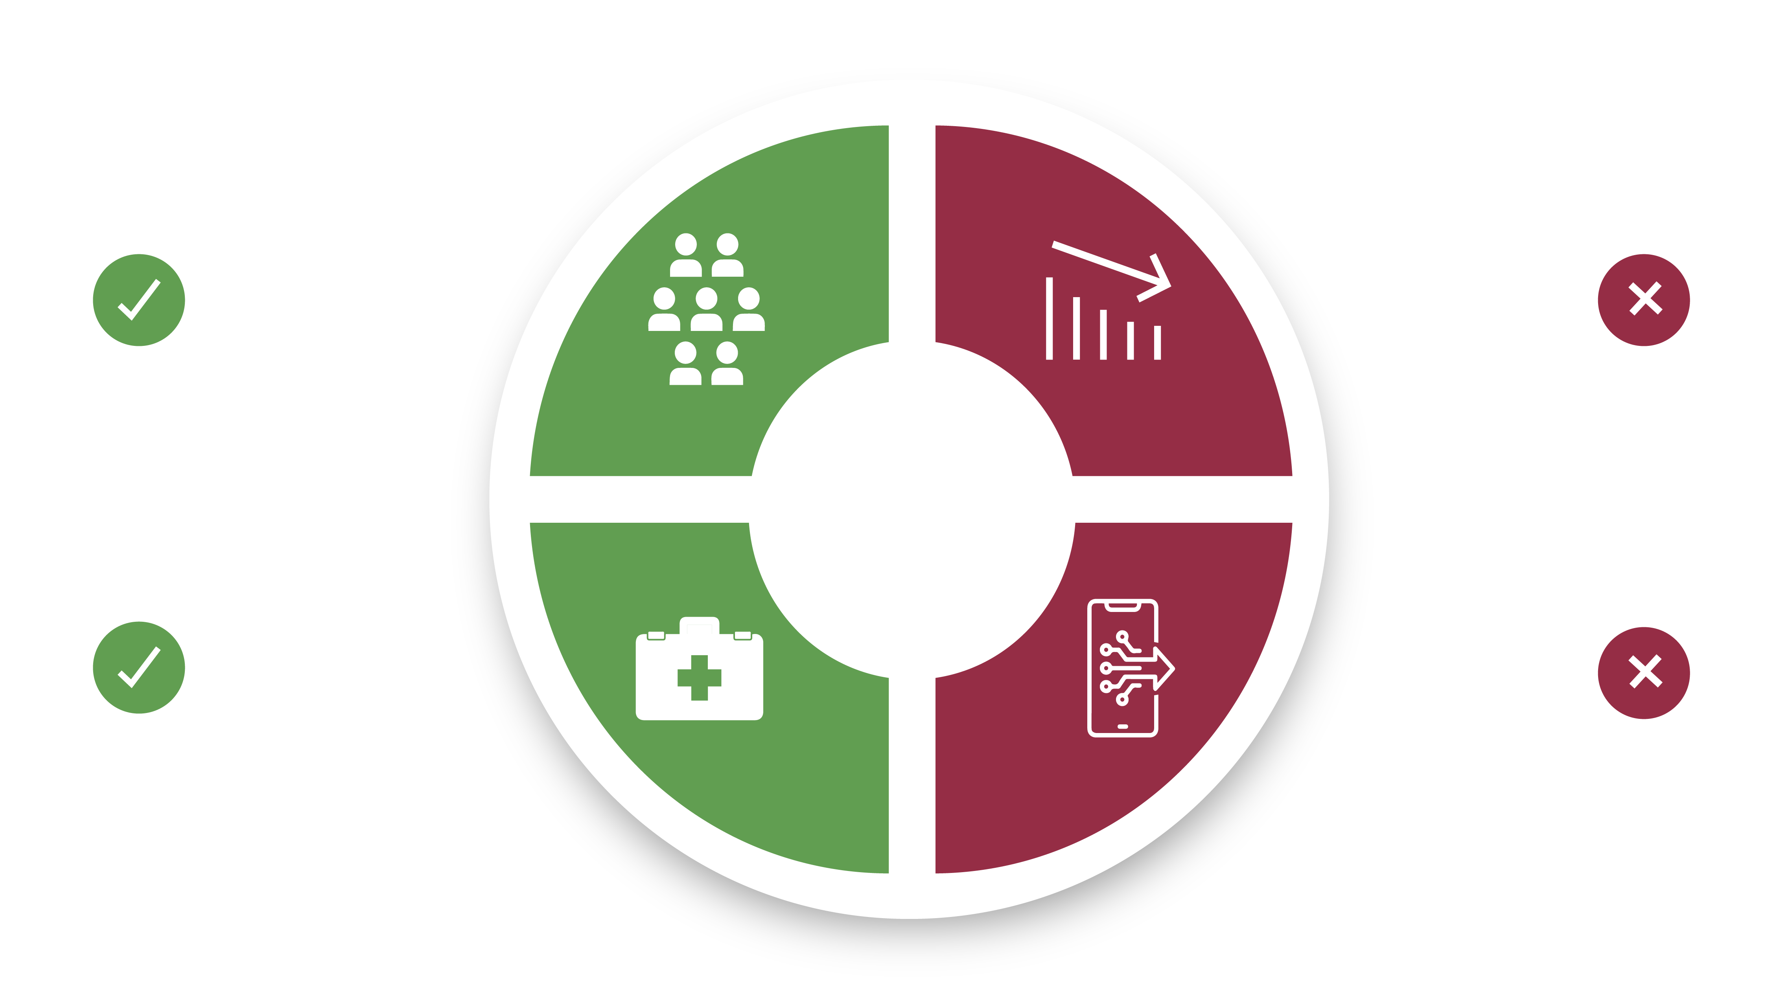
Herbal healthcare today
  Primary care of more than 70 %
  of the population
  Four times more
  herbal doctors than western doctors
Decrease among
the public trust
Lack of digital
resources
Notes:
According to the World Health Organization, the primary medical system in West Africa for more than 70 percent of the population is herbal medicine.
In Ghana for example, with a population of 30 million, there are 100,000 herbalist doctors compared to 3200 western medicine doctors.
However, following processes of modernization and urbanization, we are witnessing a decrease in trust in traditional herbal care among the public. These new times are creating a demand , to standardize the sector - from production, packaging, and training of herbal therapists.
From conversations with local therapists, we realized that there are gaps in documentation and recipes, and most of the knowledge in the field relies on verbal communication or hard-copies.
The decrease in trust and interest, caused by the absence of digital information is a threat to the vital cultural, traditional and potent knowledge that is in danger of disappearing.

Slide 3
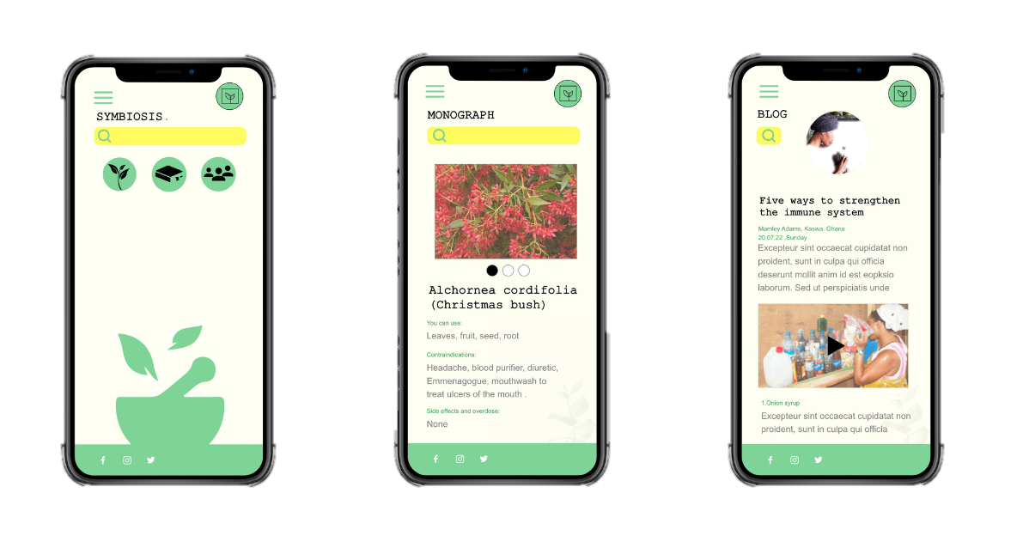
Symbiosis
The first West African digital herbal encyclopedia
Notes:
My name is Yaara and I am expert in the information systems. I recognized an opportunity to digitalize and preserve this vital knowledge, while making the most up-to-date and relevant data accessible to herbalist doctors in West Africa.
I am happy to present to you: Symbiosis -the first West African digital herbal encyclopedia
Symbiosis is a digital platform that captures and shares all known information on medicinal plants in West Africa. It will include recipes and, instructions for safe use, along with the ability to order quality raw materials and share information between community members.
We aspire for this platform to serve as a digitized version of the knowledge sharing and community ties that have preserved this information throughout generations.

Slide 4
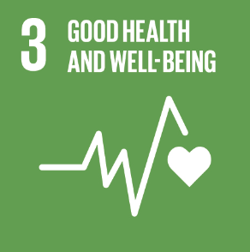
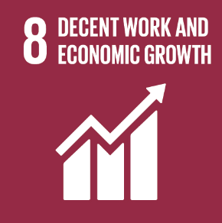
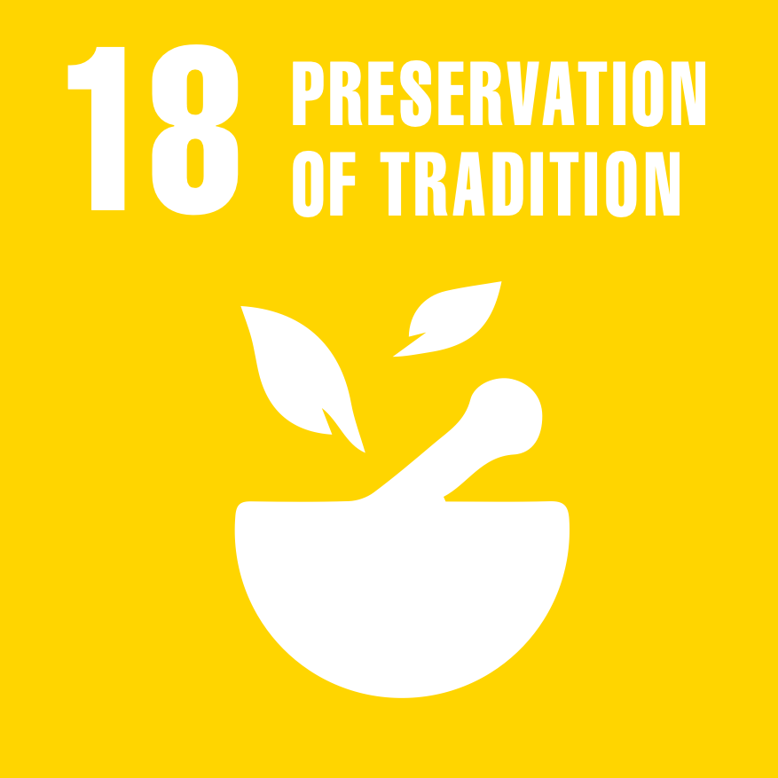
Impact
Notes:
Using a combination of traditional and scientific knowledge which our plarform provides __
allow practitioners with more accurate, reliable and efficient sources of information to bring about healing in a safer and relevant way to millions of people who rely on this service as their primary care.
Connecting traditional knowledge that has been kept within the minds of an aging generation to the forefront of modern digitized healthcare - preserving these natural indigenous medical technologies for the future of not only West Africans, but the whole world.

Slide 5

Yaara Cain
+972 546302334
yaara.ca@gmail.com
Notes:
Sounds dreamy? Symbiosis is a platform that will allow this. We are already in the stage of developing our first prototype and we expect to be able to validate our product with first end-users soon.
Now, Symbiosis is looking for its next step. If this topic touches you as well, and you care about the future of West Africa’s healthcare, please come speak to us. We are open to collaboration and look forward to hearing your feedback

